Slide 1
How Do I Choose Among Advanced HF Device Therapies?
Lindsey Aurora, MD
Advanced Heart Failure & Transplant
Henry Ford Hospital

Slide 2
Disclosures
None

Slide 3
Learning Objectives
Compare available and emerging device-based strategies for advanced heart failure, including their indications, clinical evidence, and patient-specific considerations
Collaborate effectively with the cardiovascular care team to implement individualized device strategies for patients with advanced heart failure

Slide 4
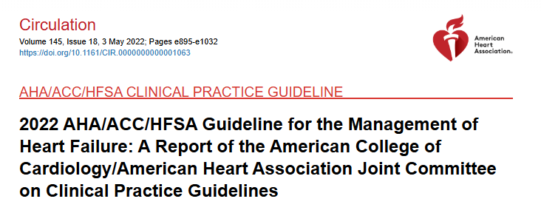
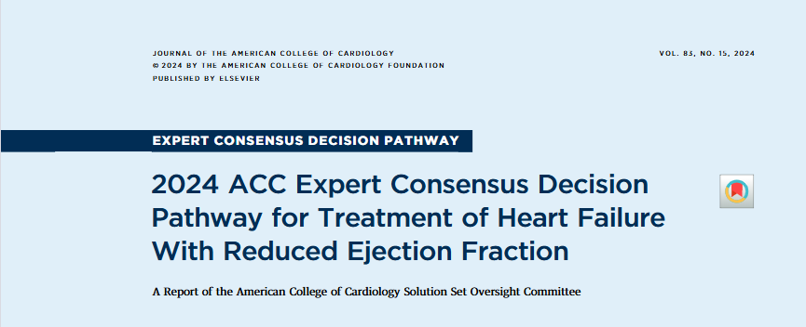
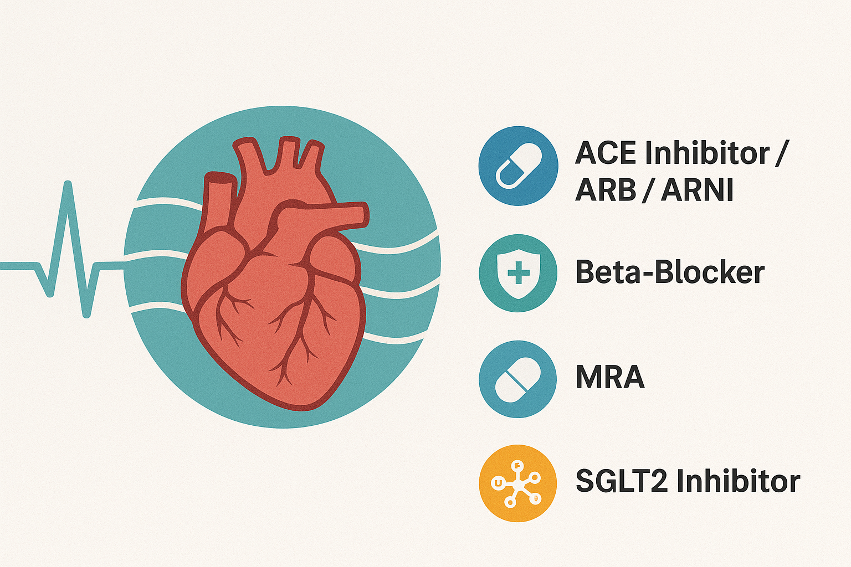
GDMT is cornerstone of therapy for patients with HFrEF
Improved substantially
Improved morbidity and mortality in this population
Target adverse neurohormonal activation
Cumulative benefit to survival
At times, medications are not enough…to stabilize clinical condition and end-organ function
Notes:
Point 1 – improved substantially in the past several decades with the implementation of ARNIs and SGLT2is and subsequences improved MMI
Point 2- …that occurs as a result of HF and add cumulative benefit to survival

Slide 5


What’s in our toolbox?
Cardiac Resynchronization Therapy (CRT)
Cardiac Contractility Modulation (CCM)
Baroreflex activation therapy (BAT)
Left Ventricular Assist Device (LVAD)
Heart Transplant

Slide 6
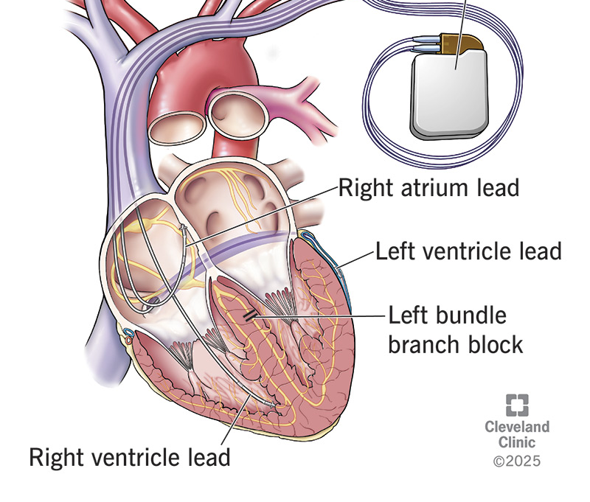
Cardiac Resynchronization Therapy
HF →structural and mechanical changes →conduction system disease → ventricular dyssynchrony + adverse remodeling
Biventricular pacing → simultaneous pacing of right and left ventricles via leads placed in RV septum and coronary sinus
Notes:
Point 1 - Normal electrical activation of the heart is uniform, and rapid, and facilitates coordinated contraction of the RV and LV . In HFrEF, structural and mechanical changes lead to conduction system disease that alters this uniformity and can lead to ventricular dyssynchrony and progressive adverse remodeling.
Point 1 – CRT also known as

Slide 7
CRT → reverse cellular, tissue, and organ-level dysfunction via molecular and genetic changes
CRT demonstrated to improve mortality, hospitalizations, symptoms, and QoL
HFrEF and HFmrEF with wide QRS (150 ms)
Select patients with QRS duration between 120-149 ms or those with a high pacing burden
~30% respond poorly to CRT and derive minimal benefit
Circ Res. 2011;109(7):716–719
Circ Arrhythm Electrophysiol. 2021;14(4), e009668
N Engl J Med. 2002 Jun 13;346(24):1845-53. doi: 10.1056/NEJMoa013168
Ochsner J. 2014 Winter;14(4):596-607.
Notes:
Point 1 – has been shown to reverse dysfunction in HF via
Point 2 – CRT basically restores ventricular synchrony ; high pacing burden for e.g. patients with Afib who undergo AV nodal ablation
Point 3 - Most of the relevant data for guidelines

Slide 8
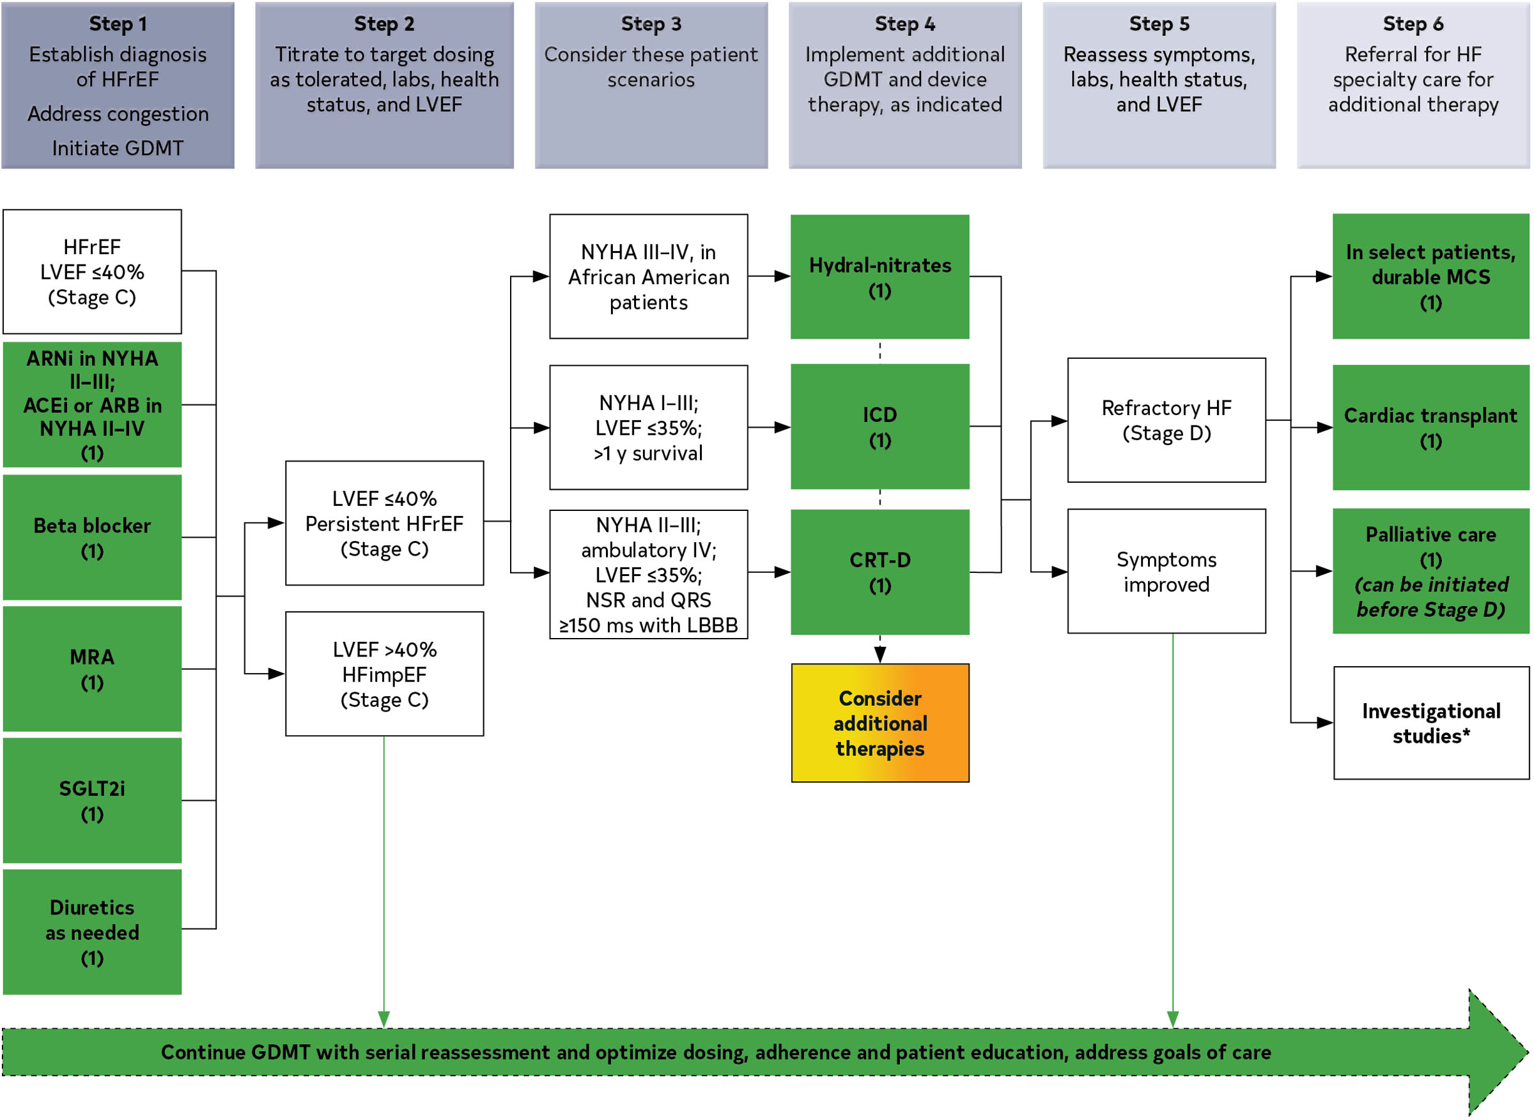
Circulation. 2022 May 3;145(18):e895-e1032. doi: 10.1161/CIR.0000000000001063
Notes:
2022 AHA/ACC/HFSA Guideline for the Management of Heart Failure: CRT is a class I recommendation
Guidelines of CRT in HF from seminal trials published from 2002-2010

Slide 9
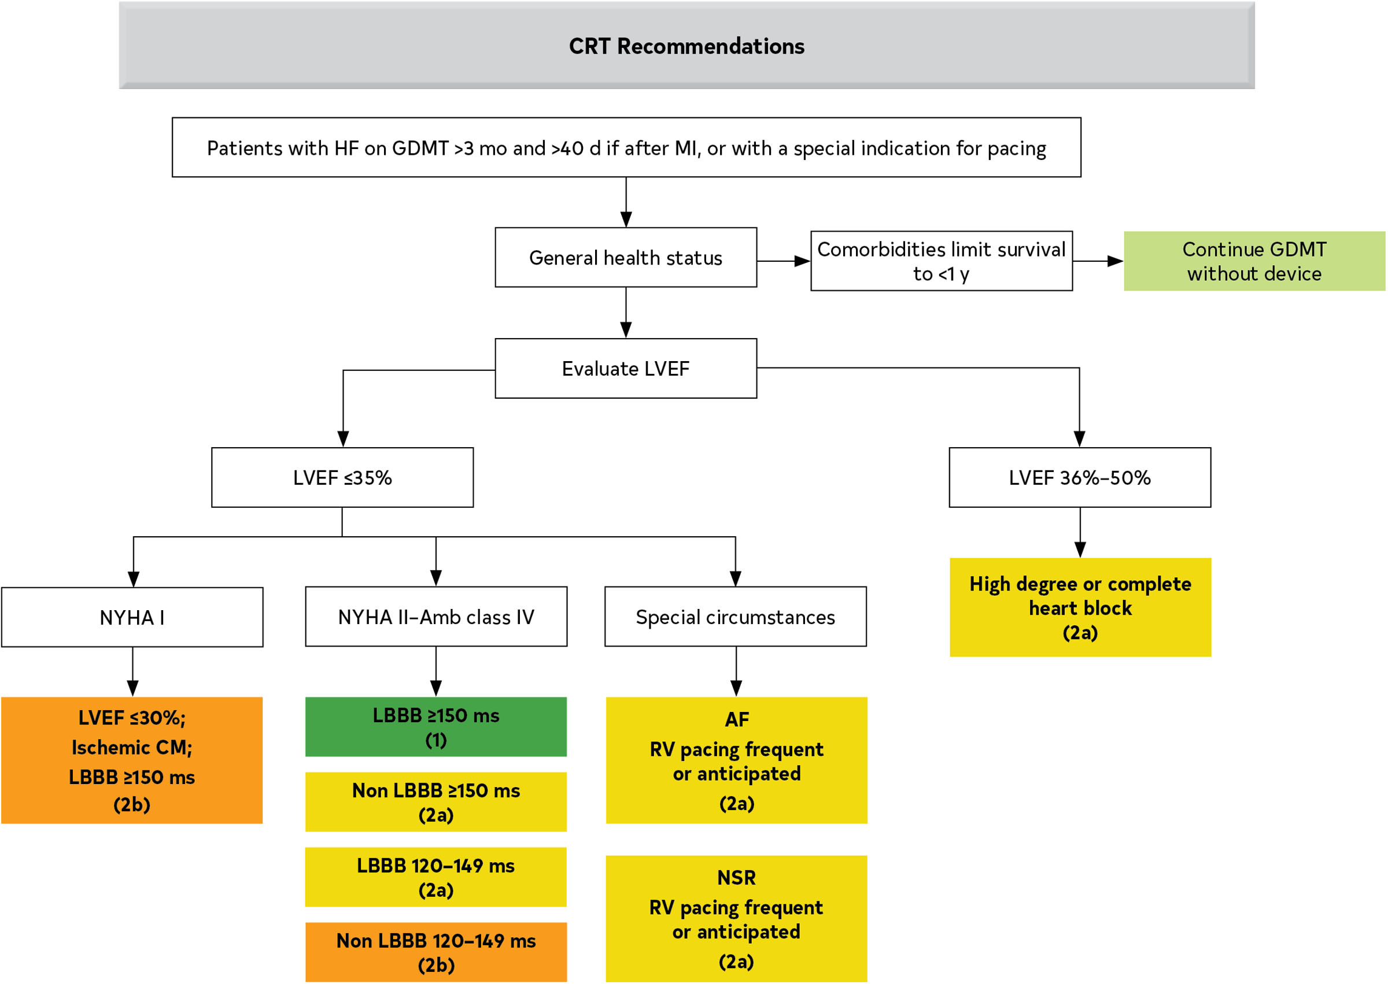
Circulation. 2022 May 3;145(18):e895-e1032. doi: 10.1161/CIR.0000000000001063
Notes:
Based on HFSA/ACC/AHA HF guidelines, this is the algorithm for CRT Indications in Patients With Cardiomyopathy or HFrEF
There are strict indications for who is eligible for CRT and thus only a subset of patients with HFrEF meet criteria for CRT

Slide 10
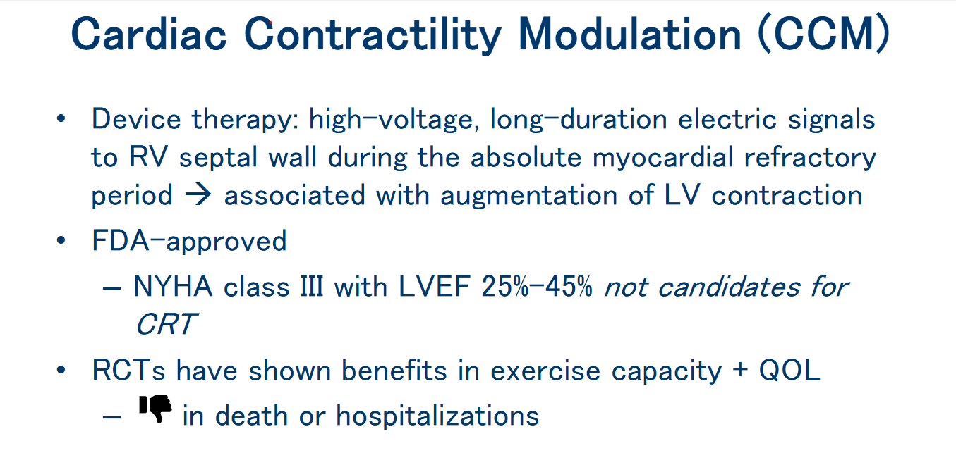
Circ Res. 1969;24(3):409–445
J Soc Cardiovasc Angiogr Interv. 2023 Dec 4;2(6Part B):101176
Circulation. 2022 May 3;145(18):e895-e1032. doi: 10.1161/CIR.0000000000001063

Slide 11
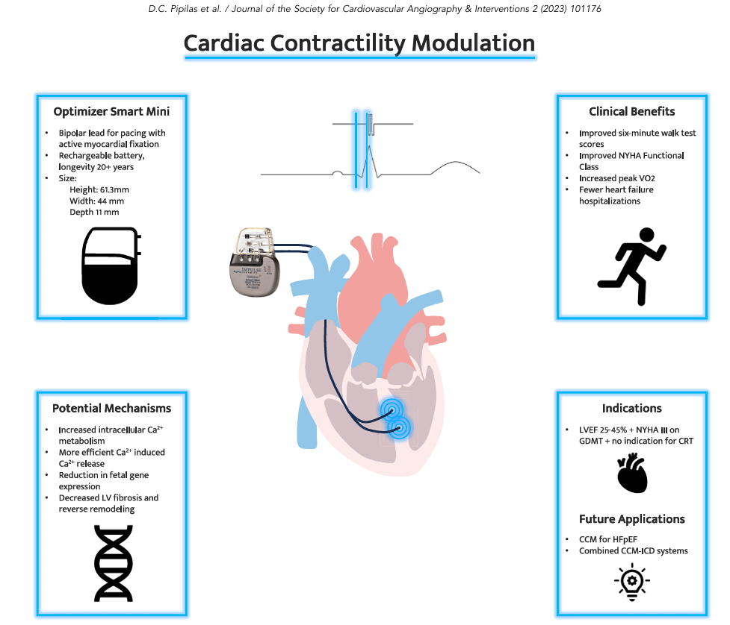
++ effect on CV outcomes including mortality and hospitalizations is suggested by some RCTs and retrospective studies but requires further study
Notes:
Dr. Pipilas and co-authors out of Mass Gen did a comprehensive review on CCM and had a nice central illustration demonstrating CCM
CCM system provides therapy for 5 to 12 hours each day in 1-hour intervals dispersed evenly over 24 hours
Longer duration of therapy has not been shown to improve outcomes
Implantation procedure is similar to that of a dual-chamber PPM

Slide 12
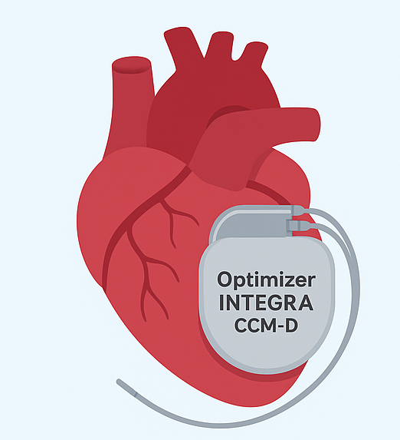
Effects of a Novel Cardiac Contractility Modulation-Defibrillator (CCM-D) on NYHA Functional Class in ICD-Indicated Patients: Integra-D Trial
Novel implantable device that provides both cardiac contractility modulation as well as defibrillation → single device
Analysis:101 patients (mean age 62.5 years; 28.7% female) indicated for ICD without CRT, stage C/D heart failure on GDMT and with LVEF of no more than 40%
Approximately 9 in 10 patients received the recommended CCM dose of at least 70% by 30 days
At 6 months, 88% of patients reported no change in NYHA symptom class + 7% had improved by two classes
Notes:
Defibrillation…successfully and safely delivers integrated therapy, while also improving symptoms, for patients who have HFrEF
Findings from the first 100 patients enrolled in Integra-D presented at HFSA 2025 Annual Meeting
Additional point: CCM assessment resulted in no inappropriate treatment during ventricular arrhythmias and no CCM leading to inappropriate ICD oversensing

Slide 13
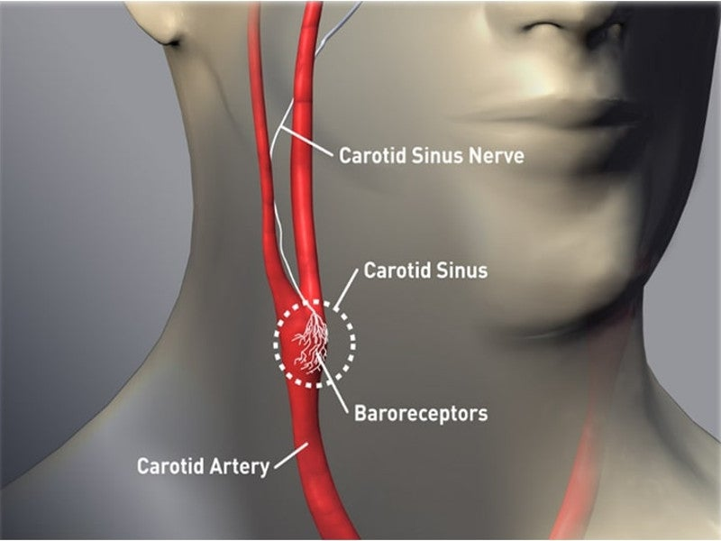
Baroreflex Activation Therapy (BAT)
Baroreflex: autonomic reflex dysregulated in HTN and HF
Stimulation of baroreflex
parasympathetic tone
sympathetic tone
Baroreceptors in walls of arteries, veins, and heart
Activated in response to rise in BP +/- volume
Arterial baroreceptors in carotid sinus and aortic arch
Activated by increase in BP
Cardiopulmonary baroreceptors in thoracic veins and heart
Activated by increase in blood volume
Parasympathetic withdrawal
Sympathetic overactivation
related to development and progression of HF
https://www.barostim.com/healthcare-professionals/
N Engl J Med 2020;382:163-78
Notes:
Point 1 – key autonomic reflex; dysregulated in patients with HTN and HF
Point 3 - Baroreceptors are embedded in the walls of the major arteries, veins, and the heart and are activated in response to a rise BP and/or volume
Arterial baroreceptors in the carotid sinus and aortic arch are activated mainly by an increase in BP
Cardiopulmonary baroreceptors in the thoracic veins and the heart are activated mainly by an increase in blood volume

Slide 14
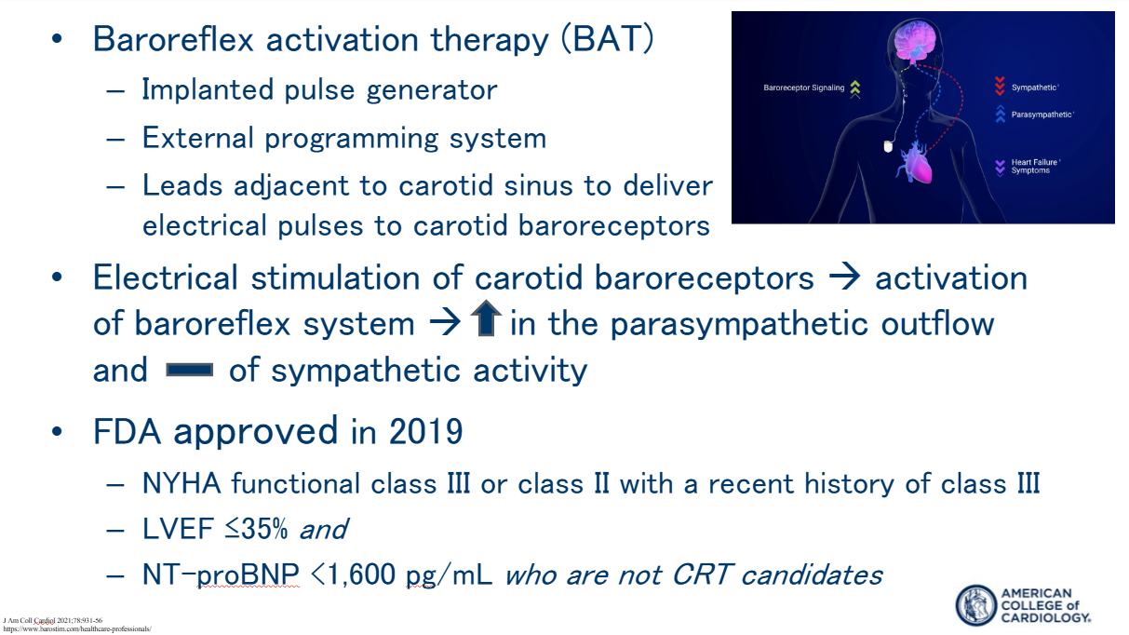

Slide 15
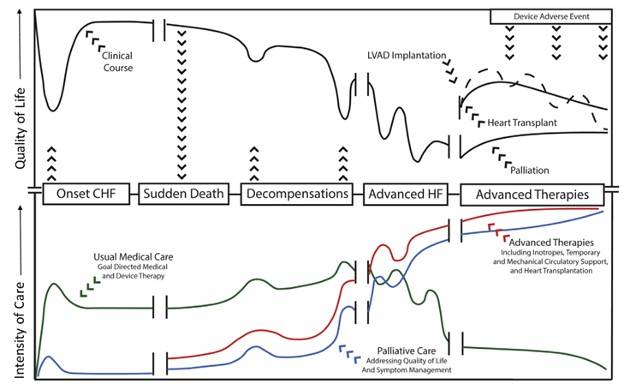
Advanced Heart Failure
JACC Heart Fail. 2020 Jul;8(7):523-536
Notes:
This shows expected natural history of the course of AHF including advance therapies and palliative care intervention. Unpredictable clinical course of HF can offer challenges to correctly identify the optimal timing of referral to a HF specialist. Whereas some HF cases are abrupt and obvious, others are related to progressive diseases that evolve subtly over time.
Concept of early referral to avoid debilitation and end-organ dysfunction that accompanies progressive advanced HF and may preclude candidacy for advanced therapies
Palliative and supportive approaches to the care of patients with HF is inherent to their overall care and should be incorporated throughout the course of illness by all health care professionals. This has a role across the stages of HF, starting early in the course of illness, intensifying in end-stage disease, and extending into caregiver bereavement

Slide 16
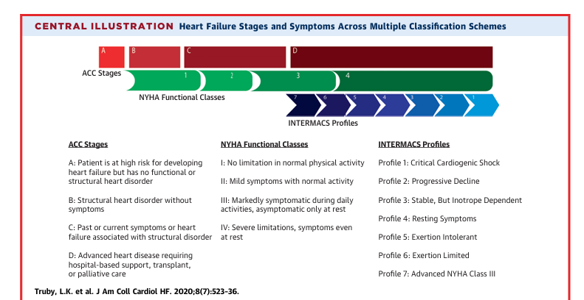
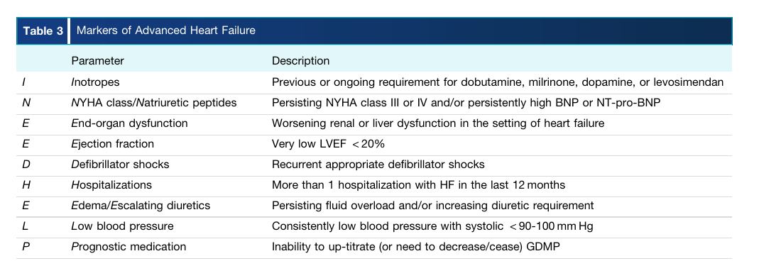
Eligibility for and timing of Tx/LVAD evaluation requires a comprehensive evaluation of all comorbidities that may impact surgical risk, post-op QOL, and survival
J Heart Lung Transplant. 2024 Oct;43(10):1529-1628.e54
Notes:
Multiple classification systems have been developed to characterize patients with HF and define those with advanced disease. For example, NYHA functional class IV defines those with symptoms at rest and with any physical activity.
The Interagency Registry for Mechanically Assisted Circulation (INTERMACS) classification system was developed to risk stratify patients with advanced HF to better define prognosis and urgency of intervention. These 3 classification systems can be used in parallel in order to more precisely define where an individual patient lies on the spectrum of this progressive disease.
Long-term advanced HF therapies should be considered in whom GDMT and device therapies and device therapy has failed to result in hemodynamic improvement to improve symptoms or preserve end-organ function

Slide 17
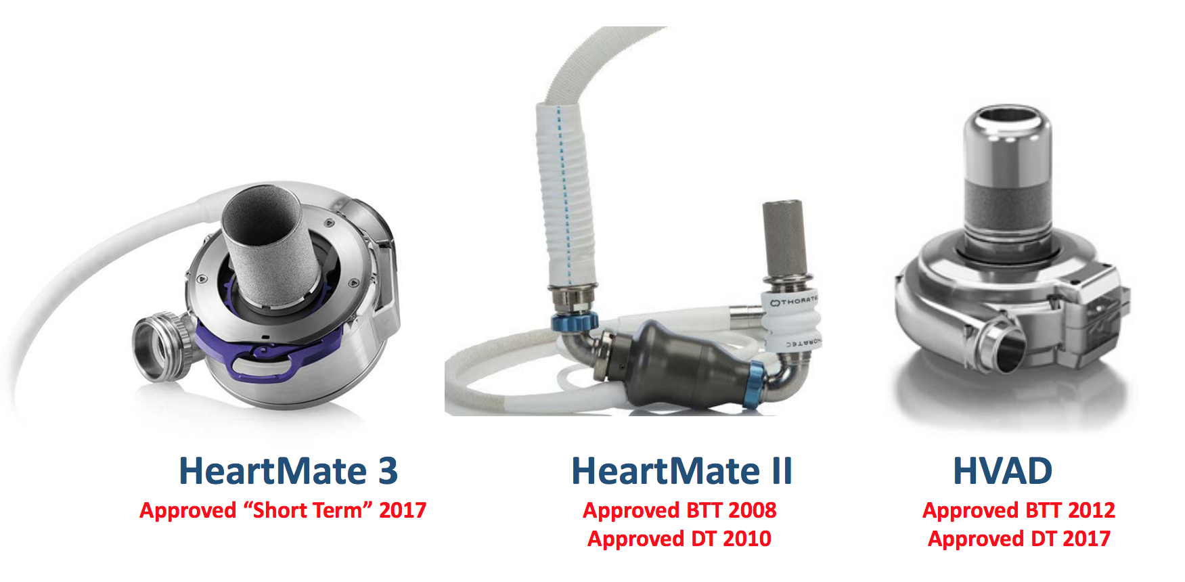
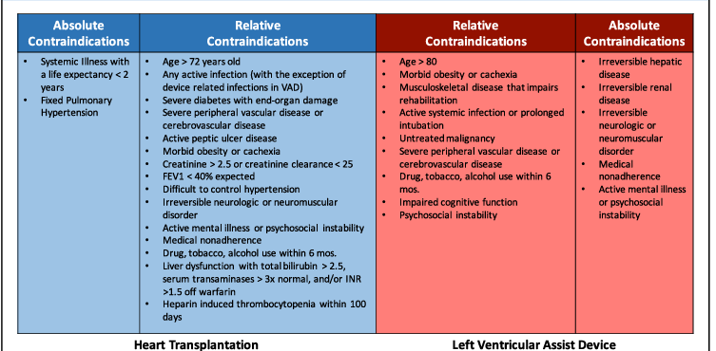

JACC Heart Fail. 2020 Jul;8(7):523-536
J Heart Lung Transplant. 2024 Oct;43(10):1529-1628.e54
Notes:
Tremendous strides in the durable MCS space –
- HM3 received its initial FDA approval in August 2017 for short term support (BTT or myocardial recovery) in patients with advanced heart failure - supported by data from the MOMENTUM 3 trial, and later FDA approval in October 2018 expanded its use to include long-term hemodynamic support (DT).
- HM3: Smaller than HM II but includes wider blood-flow passages → less wear and tear on circulating blood cells so less hemolysis
- Full magnetically levitated frictionless pump with no mechanical bearings → more durability
- Continuous flow but has intrinsic pulse → reduce blood stasis and reduce thrombosis

Slide 18
Roles and Responsibilities of MDC HF Team
🫀 Heart failure cardiologist – Optimize candidate selection & medical management
🫀 Cardiothoracic surgeon – Assess surgical candidacy & explain operative risks
👩‍⚕️ Transplant coordinator/nurse – Educate patients & guide transplant process
🦠 Infectious disease expert – Prevent & manage infection risks
💊 Clinical pharmacist – Optimize & monitor complex drug regimens
🧬 HLA specialist/Immunology – Match donors & recipients immunologically
🤝 Social worker – Evaluate psychosocial support & adherence potential
🧠 Psychologist/Psychiatrist – Assess and support mental health needs
🥗 Registered dietician – Provide nutrition optimization pre- and post-transplant
🏋️ Physiotherapy – Support physical rehab and frailty assessment
🌿 Palliative care specialist – Enhance quality of life & symptom management
J Heart Lung Transplant. 2024 Oct;43(10):1529-1628.e54
Notes:
Applies to not only transplant but also LVAD
Optimal medical and psychosocial evaluation of a patient for AHF therapies necessitates collaborative efforts of a multidisciplinary team
Goal is to optimize the management of chronic illnesses and improves outcomes

Slide 19
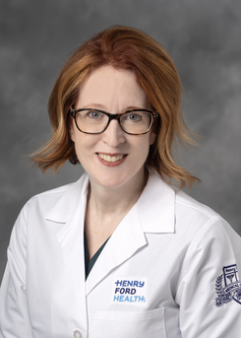
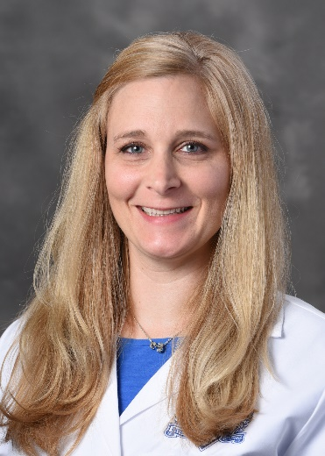
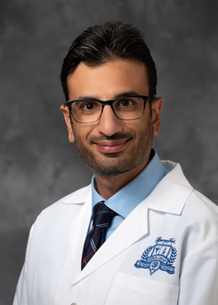
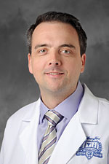
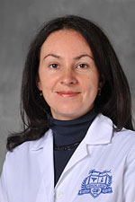
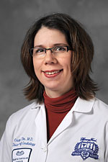
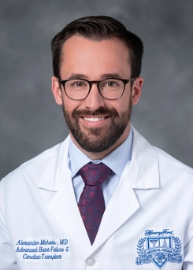
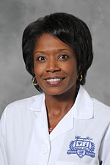
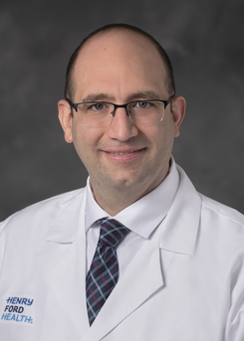
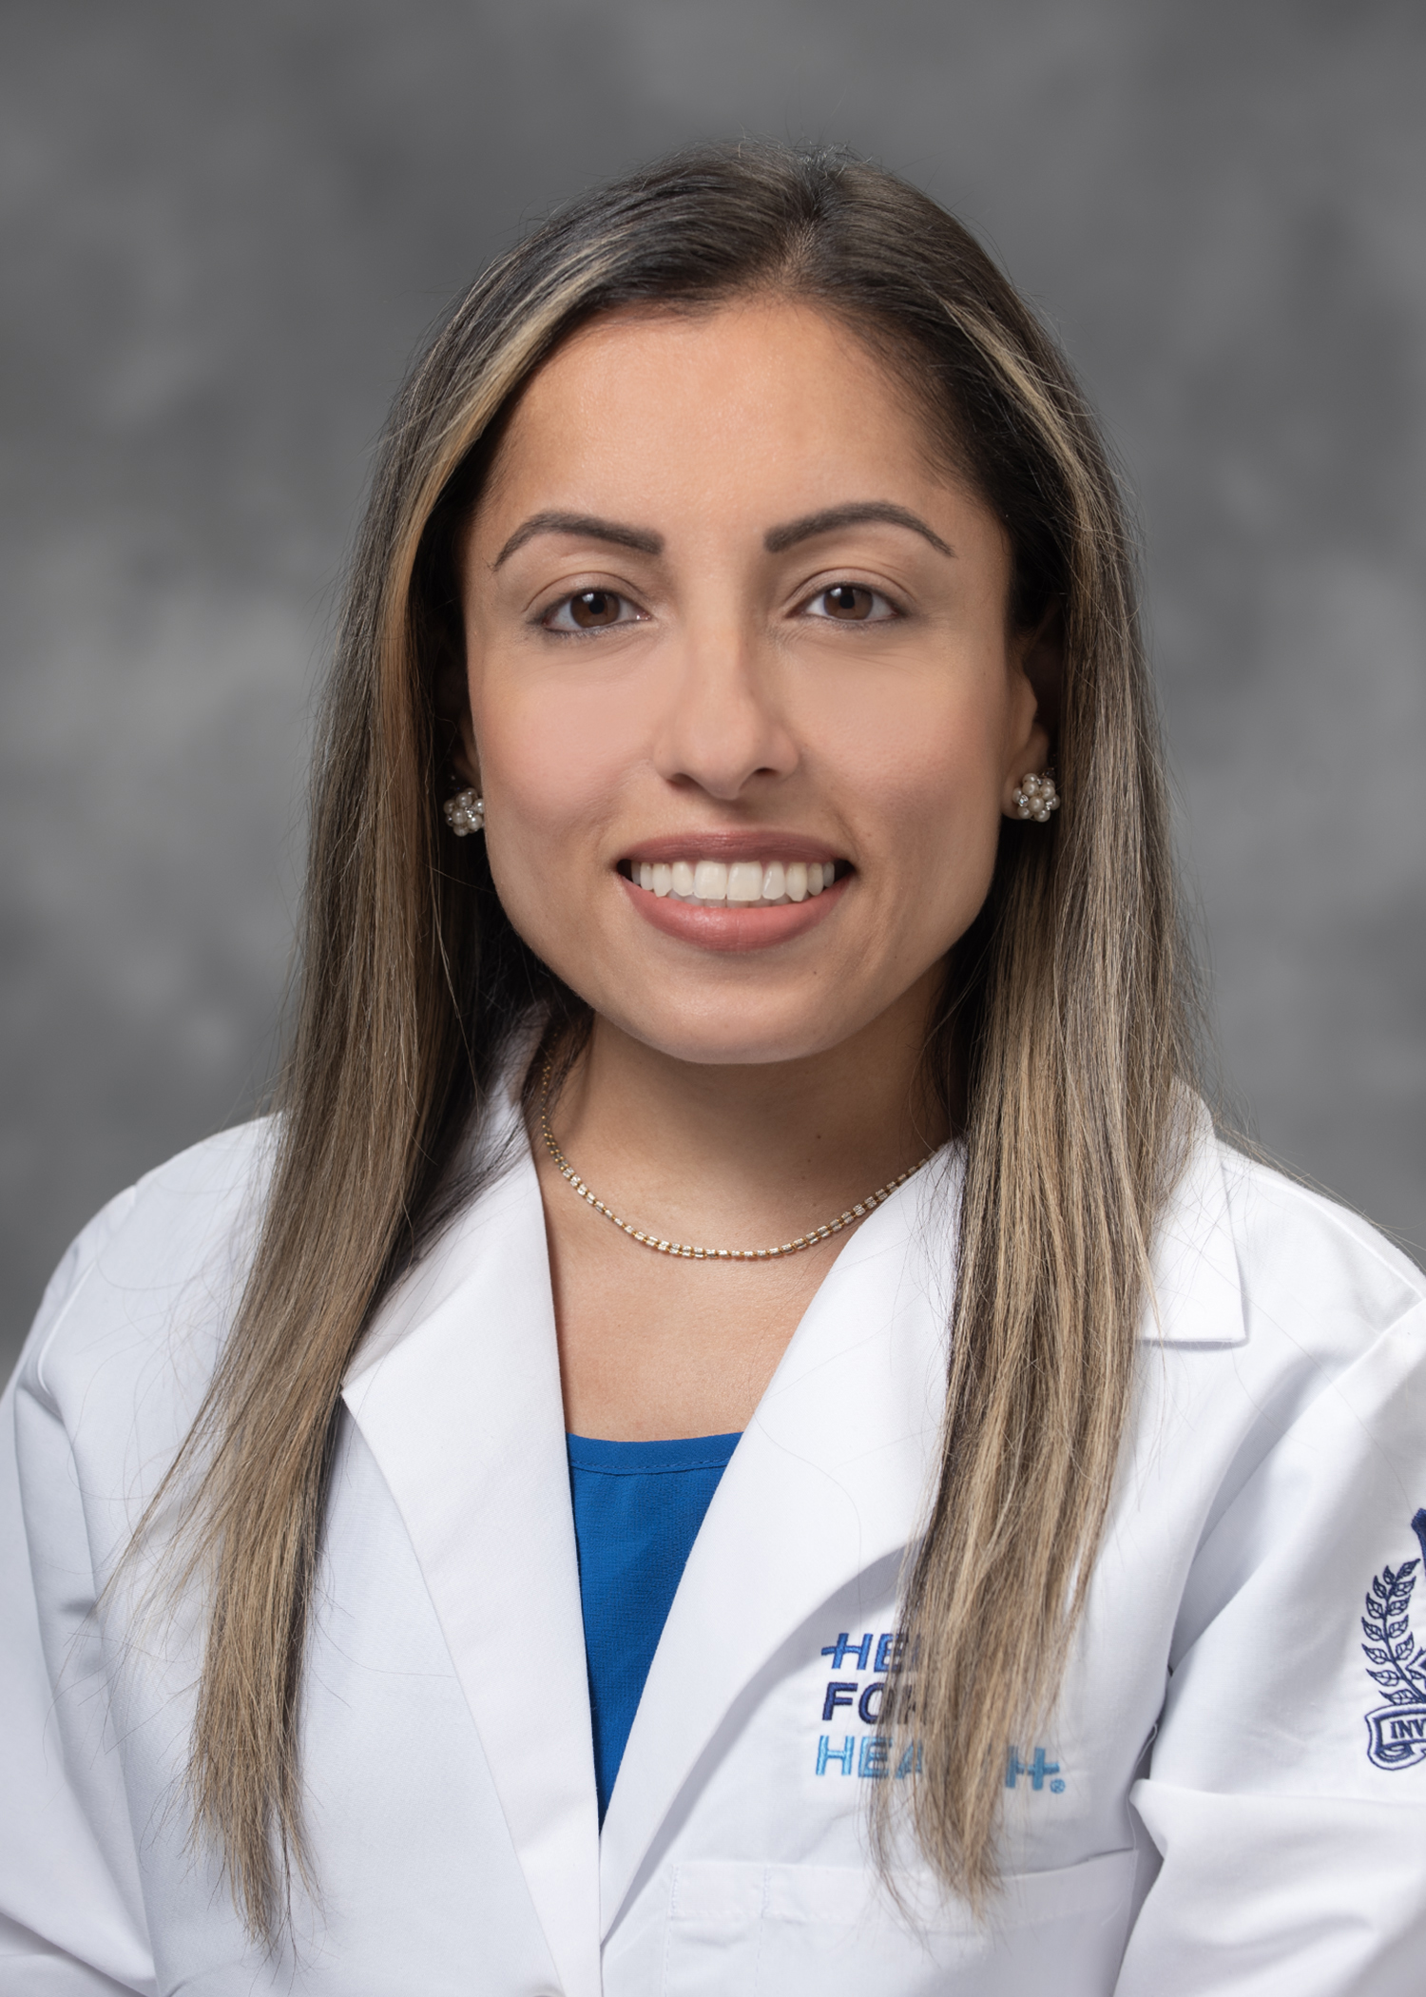
Henry Ford Advanced HF/Tx Team
Jennifer Cowger
Gillian Grafton
Bashar Hannawi
David Lanfear
Yelena Selektor
Cristina Tita
Alex Michaels
Celeste Williams
Waleed Al-Darzi
Lindsey Aurora

Slide 20
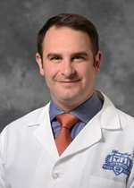
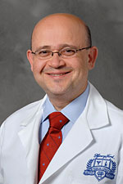
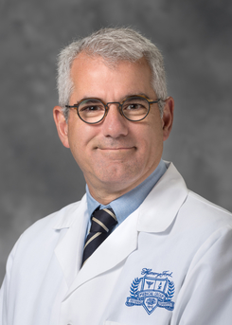
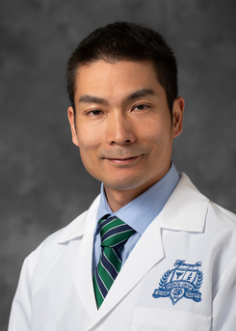
Kyle Miletic
Hassan Nemeh
Dimitrios Apostolou
Daizo Tanaka

