Slide 1
Identifying the Right Patient: Who, Why, When and How
Supriya Shore MD
Assistant Professor Section of Heart Failure University of Michigan
Notes:
Hi Everyone! My name is Supriya Shore. I am a heart failure cardiologist at the University of Michigan. I will be talking today about identifying the right patient with heart failure for monitoring devices.

Slide 2
Disclosures
No relevant disclosures
Notes:
I have no relevant disclosures

Slide 3
Learning Objectives
Identifying patients with heart failure who may benefit from device monitoring
Identify available device monitoring strategies
Notes:
The learning objectives from today’s talk include identifying patients with heart failure who may benefit from device monitoring strategies and learning about currently available device monitoring strategies.

Slide 4
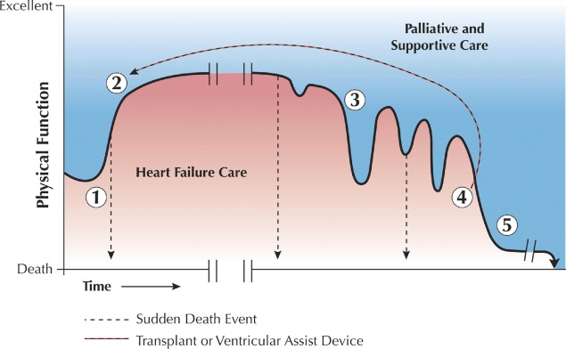
Heart Failure is Chronic & Progressive
Mortality:
6 month - 50%
1 year - 75%
Mortality:
1 month - 10-20%
1 year - 35%
SJ Goodlin. JACC. 2009; 54 (5): 386-396
Notes:
We all know that heart failure is a chronic and progressive condition. Patients begin at time point 1 with index hospitalization or a clinic visit with symptoms and are diagnosed with heart failure. Over the course of time, they feel better with medications and usually reach a stable plateau for variable time periods, following which there are recurrent exacerbations leading to rehospitalizations and progressive decline in functional status, eventually leading to death. Terminal stage or Stage D of heart failure are associated with a 6 month mortality of upto 50% and 1 year mortality of 75%. However, Stage C heart failure is also associated with 1 month mortality of upto 20% after a single hospitalization and a 1 year mortality of 35%. This highlights the importance of aggressive management of heart failure early on in the disease process.

Slide 5
Contemporary Era of HF Therapies
Heart Failure Monitoring
Monitoring Vitals
ARNI*
Or ACEI/ARB
(Class Ia)
β
Blocker
(Class Ia)
Aldosterone antagonist
(Class Ia)
Remote PA
sensor
HF
Multiparametric
Systems
SGLT-2
Inhibitors
(Class Ia)
Diuretics
(Class Ia)
Hydralazine/ Isosorbide
Dinitrate *
(Class Ia)
Notes:
Contemporary era of heart failure therapies comprises of 6 classes of medications that are recommended for patients with heart failure with reduced ejection fraction. However, in addition to these therapies heart failure monitoring strategies play an important role in titrating medications and preventing hospitalizations. While traditionally, patients have been asked to monitor vitals, especially daily weights, newer strategies also include use of remote pulmonary artery sensor and multiparametric system embedded in ICDs.

Slide 6
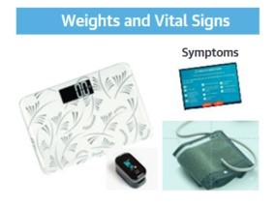
Remote Patient Monitoring Systems
Notes:
We will start with a brief overview of available remote patient monitoring systems and begin with one that we use most commonly in clinical practice – asking patients to check their weights and other vitals daily and notify our heart failure programs of significant changes.

Slide 7
Tele-Monitoring
HF re-hospitalizations are reduced by early follow-up
Benefits of tele-monitoring noted in smaller real-world studies have not translated into clinical trials
Notes:
Data show that among all interventions that prevent heart failure re-hospitalizations, early clinic follow-up is a key strategy. However, benefits of tele monitoring of patient signs and symptoms have been shown only in smaller, single-center studies. Larger clinical trials have not consistently shown this benefit.

Slide 8
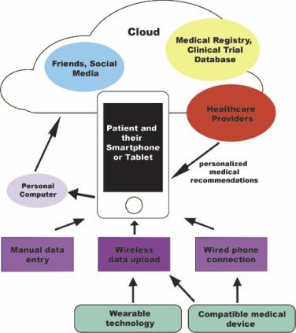
Patient-Activation Tools
EPIC-HF studied delivery of a 3-minute video with a 1-page checklist comprising GDMT
Patients encouraged to bring up one item for optimization at a clinic visit
Notes:
However, in the current day and age where every patient likely has a smartphone – newer tools are available to help engage patients in their care. The EPIC-HF trial studied the delivery of a 3-minute video and a 1-page checklist of heart failure medications to the patient directly a few days prior to an upcoming visit. The video explained importance of GDMT and how patients could help engage in their own care and encouraged them to bring up one medication or item for optimization at their upcoming clinic visit.

Slide 9
Patient-Activation Tools
Intervention led to more treatment intensification compared to standard of care
LA Allen. Circulation.143(5): 427-437
Notes:
145 patients were randomized to the intervention and control arm each across a single, large US healthcare system. Patients randomized to the control arm showed higher rates of initiation and intensification of GDMT, with a composite endpoint rate that was almost 20% higher than in the control arm. This highlights how simple handheld devices can be used in heart failure management

Slide 10
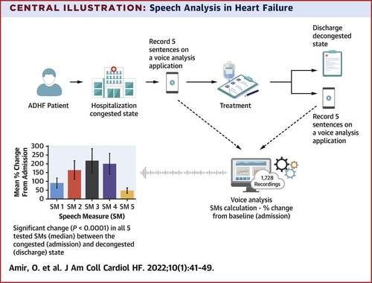
Novel AI Based Tools
Notes:
More recently, novel artificial intelligence-based tools are being studied. In this small, single center study of 40 patients, the authors studied a voice analysis application on a smartphone to measured differences when patients are in a dry and wet state. Hospitalized patients with decompensated heart failure were asked to say 5 sentences. Following treatment and prior to discharge in a decongested state, patients again recorded these same 5 sentences. A voice analysis was conducted by the app that measured changes in utterances from wet to dry state, and a significant difference was noted between these 2 states for every sentence. Tools like this hold promise as they would be readily accessible to patients.

Slide 11

Patient Activation Tools
Main limitation is need for compliance
Notes:
However, the main limitation with all patient-led monitoring tools is the need for compliance. Management of heart failure is an uphill task, overwhelming most patients due to the need for multiple medications, changes in lifestyle, in addition to the need for monitoring. Hence patient engagement is key and simple tool targeting education such as that studied in EPIC-HF should be incorporated.

Slide 12
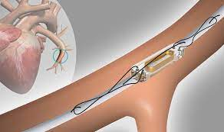
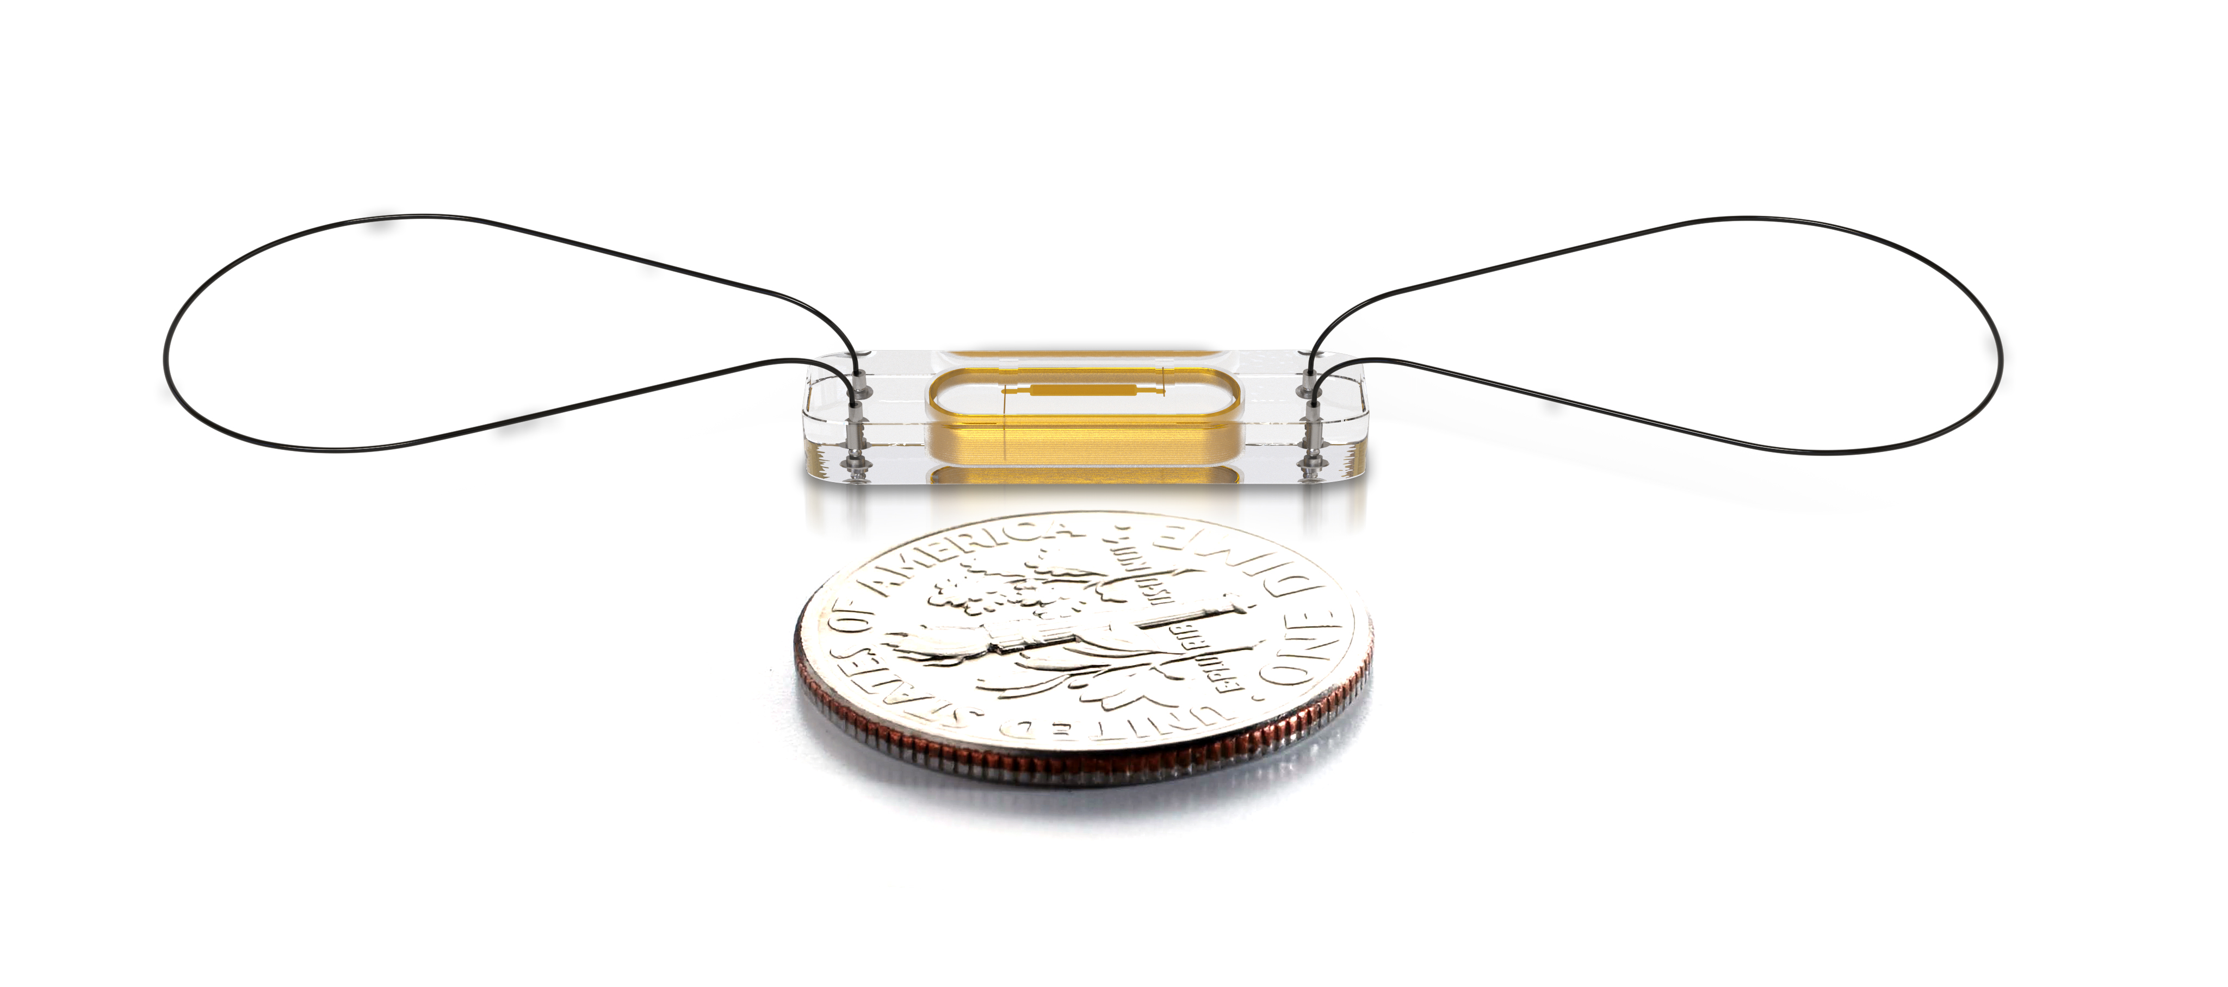
Remote PA Pressure Monitoring
Pulmonary artery pressure sensor
Transmits real-time data on pulmonary artery pressure and the diastolic pressure approximates the wedge pressure
Notes:
Moving onto remote pulmonary artery pressure monitoring systems. The procedure is similar to how a right heart cath is performed with the sensor being implanted in a branch pulmonary artery. This sensor transmits real-time data on the pulmonary artery pressure, with tracings that can be seen on an online platform. Both pulmonary artery diastolic pressure ad a mean pulmonary artery pressure can be assessed based on these tracings.

Slide 13
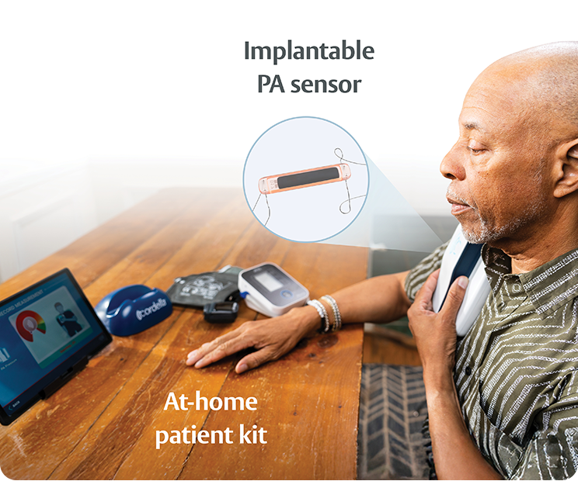
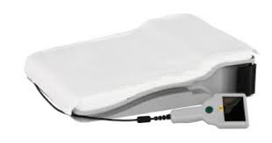
Remote PA Pressure Monitoring
Patient equipment
Notes:
There are currently two remote pulmonary artery monitoring systems available that differ in the patient-facing interface. The cardiomems system shown on the left side provides the patient with a smart pillow that they lay on with a Bluetooth implanted inside that connects to the implanted sensor and transmits reading wirelessly. The Cordella system provides patients with a handheld device that they place over their chest, which then wirelessly transmits readings.

Slide 14
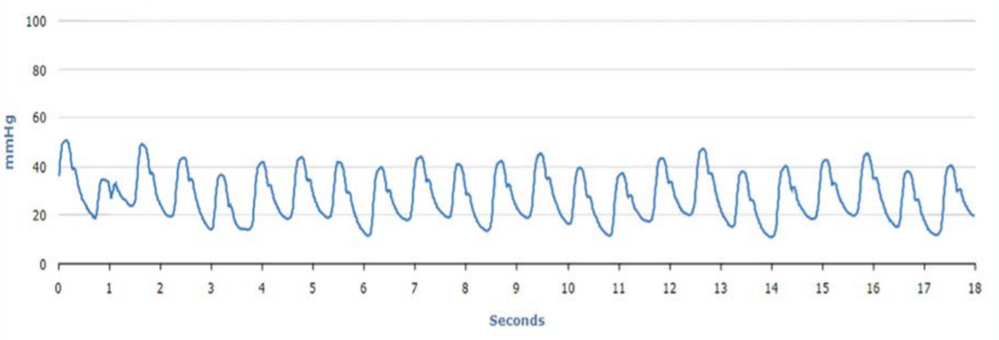
Remote PA Pressure Monitoring
Patient equipment
Notes:
This is an example of the tracing received from a patient with a remote pulmonary artery pressure monitor. The tracings are of high quality, making pressure assessments quite facile.

Slide 15
Remote PA Pressure Monitoring
Set protocols personalized to the patient for diuretics
For example:
Euvolemic range: <18
Torsemide 50mg daily
Mildly volume overloaded: 18-24
Torsemide 100mg daily with Potassium 10mEq daily
Severely volume overloaded: >24
Torsemide 100mg twice daily with Potassium 20mEq daily
Notes:
Typically, based on pressure tracings obtained, personalized protocols are set up for every patient that guide medical therapy. Usually this includes diuretics but should also involve guideline directed medical therapy that also helps improve filling pressures providing opportunities to optimize a patient’s regimen. A nursing team will review these tracings on every patient every week to 2 weeks with increased monitoring frequency if someone is decompensated until they recover.

Slide 16
Remote PA Pressure Monitoring
Initial data from CHAMPION (NYHA class III or worse with a HF hospitalization): Cardiomems associated with reduced HF hospitalization with a relative risk reduction of 37% and absolute risk reduction of 12%
Not a blinded trial, so it did not receive FDA approval
Givertz M. JACC. 2017 Oct, 70 (15) 1875–1886.
Notes:
Initial data on these pulmonary artery monitoring systems came from the CHAMPION trial. This trial enrolled patients with NYHA class 3 or worse with a heart failure hospitalization. Cardiomems was associated with a reduced risk for heart failure hospitalization with a relative risk reduction of 37% and absolute risk reduction of 12%. However, since the trial was not blinded it did not receive FDA approval.

Slide 17
Remote PA Pressure Monitoring
GUIDE-HF was completed. Results affected by COVID-19 pandemic (reduced HF hospitalization rate). Pre-COVID-19 analysis suggests benefit in reducing HF hospitalizations. Class 2b recommendation
Extended to NYHA class II and III with HF hospitalization or BNP>250
Similar benefits in HFpEF and HFrEF
Consistent across age, sex, race
Zile M. JACC HF. 2022 Dec, 10 (12) 931–944.
Notes:
The next trial examining the efficacy of remote pulmonary artery pressure monitoring systems was GUIDE-HF. Unfortunately, this trial was impacted by the COVID-19 pandemic, which in itself led to lower hospitalization rates. GUIDE-HF enrolled patients with both NYHA class 2 and 3 who had a heart failure hospitalization or an elevated BNP. The pre-COVID analysis of enrolled patients showed a significant benefit in reducing heart failure hospitalizations giving it a class 2b recommendation in current guidelines. It noted similar benefits in patients with HFrEF and HFpEF and the benefits in subsequent studies have also translated similarly across various age groups, and by race and sex.

Slide 18
Remote PA Pressure Monitoring: Real-World Challenges
Still need some compliance
Sometimes need recalibration (weight change)
Cost ($44,832 per QALY over standard)*
*Schmier J. Clinical Cardiology. 2017 Mar 8;40(7):430–436
Notes:
However, remote PA sensors still come with challenges. They still rely on patients transmitting their readings which can sometimes be challenging. Occasionally, these devices require recalibration, which necessitates a repeat right heart catheterization, and the sensor tracings are approximated with real-time PA catheter tracings. This usually arises if there is a large weight change for the patient. Finally, these are expensive and rely on a team with an average cost of approx. $45000 per QALY over standard HF costs.

Slide 19
Thoracic Impedance Monitors
Embedded in ICD
Not translated into real-world benefits because:
No standardized measures
Lack of timely response
Notes:
Thoracic impendance monitors are embedded in several available ICDs these days. Common examples include Optivol fluid index™. These measure changes in resistance to current flow in the chest cavity that varies by fluid status. However, studies evaluating these monitors have not shown benefit in reducing HF hospitalization in the real world. This is likely due to a lack of timely response (device checks are done remotely on a monthly basis at best), and there is no standardization of these measures.

Slide 20
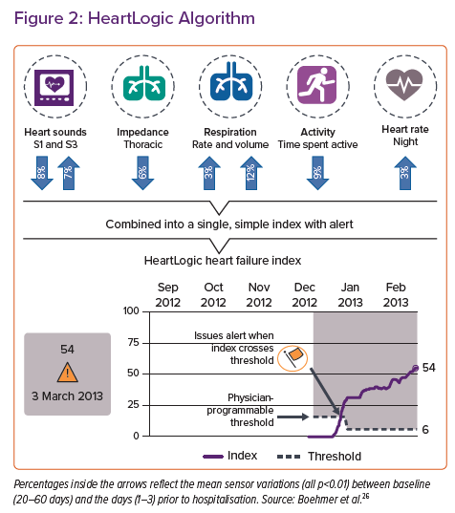
Multi-parametric Systems
Heart Logic
Ascertained using built in algorithm from CRT-D
Calculates a score which helps classify patients into an “in-alert” or “out of alert” phases
Notes:
More recently novel multiparametric systems are built into CRT-D and now some ICD. These sensors detect changes in 5 parameters including, heart sounds, thoracic impendance, respiratory rate and volume, time spent being active and nocturnal heart rate. These 5 parameters are scored and transformed into a single simple index or score (called the heart logic score) which then classifies patients into 2 phases – either in alter or out of alert phase.

Slide 21
Predictors of HF hospitalizations in Heart Logic Study
Variable | HR (95% CI)
Heart Logic >16 | 4.78 (2.94-7.75)
NT-proBNP (per 2 fold increase) | 1.35 (1.18-1.54)
NYHA class III/IV | 2.04 (1.13-3.67)
Creatinine (per 2 fold increase) | 0.99 (0.64-1.51)
Gardner RS, Circ: HF .2018 Jul;11(7):e004669
Notes:
In a nonrandomized, multicenter, international study of 900 patients, use of the Heart Logic multisensor index predicted impending HF decompensation. In a post-hoc analysis that looked at predictors of a HF hospitalization, a heartlogic score of >16 was the strongest predictor. Notably, this model was adjusted for several other markers that we commonly use in clinical practice such as NT-proBNP, clinical symptoms and changes in creatinine.

Slide 22
When to Refer to Heart Failure Clinic?
Iv Inotropes
NYHA class IIIb/IV symptoms or persistently elevated BNP/proBNP
End organ damage
EF< 35%
Defibrillator shocks
Hospitalizations > 1
Edema despite escalating diuretics
Low BP/High HR
Progressive intolerance to GDMT
Notes:
Finally, we will review when a patient should be referred to the heart failure clinic. A simple mnemonic I NEED HELP summarizes these indications and is endorsed in the latest ACC/AHA HF guidelines and the 2024 expert consensus pathway for HFrEF by ACC/AHA. This mnemonic stands for I implying need for inotropes at any time point including briefly during a hospitalization. N stands for New York heart association class IIIb/IV symptoms or persistently elevated Natriuretic peptides. E stands for end organ damage (for example worsening renal or hepatic function). The next E signifies a severely reduced ejection fraction of <=35%. D represents defibrillator shocks. H stands for recurrent hospitalizations. E signifies edema that is refractory to high dose or escalating doses of diuretics. L stands for low blood pressure or high heart rate and P signifies progressive intolerance to guideline directed medical therapy. If your patient meets any of these criteria, please consider referring them to a HF clinic as they may benefit from intense team based management and/or may meet criteria for advanced therapies for heart failure.

Slide 23
Conclusions
Device therapies can add to the management of NYHA class II-III patients
Patient monitoring systems, such as PA sensors and Multiparametric Systems, can help reduce hospitalizations
Patient activation tools can help optimize treatment
Notes:
In conclusion, we reviewed device therapies in the management of NYHA class II-III patients and their specific roles ranging from patient activation and engagement to medication/therapy management. Patient monitoring systems such as pulmonary artery sensors and newer multisensory systems implanted in CRTD/ICDs can help reduce HF hospitalizations that are associated with a high morbidity and mortality. HF management needs 2 active partners – an invested patient and a clinical HF team and patient activation tools can help optimize treatment for heart failure.

Slide 24
Thank You!
Notes:
Thank you to the ACC for this opportunity.

