Slide 1
Device Therapy: When to Watch, When to Act
Case Presentation
Milena Jani, MD, MSc
Advanced Heart Failure Cardiologist, Corewell Health West

Slide 2
Disclosures
None

Slide 3
Objectives: Stepwise Device therapy
Demonstrate how to sequence and integrate monitoring and therapeutic devices into HF care pathways to reduce hospitalizations and improve quality of life.
Notes:
Persistently symptomatic despite GDMT

Slide 4
The 3 Buckets
Optimization phase
Maintenance phase
Red zone
Notes:
Think of your heart failure patient population as belonging in the 3 buckets. Those that are in maintenance phase and those that keep sliding back in and out of optimization to red zone, we will work through the tools we have when medications fail

Slide 5
Case Presentation
74M, ischemic cardiomyopathy
NYHA IIIb
GDMT has been optimized
EKG reveals sinus rhythm with LBBB
Echocardiogram reveals LVEF 22% and moderate mitral regurgitation.

Slide 6
Questions to consider
Has CRT been considered and optimized?
Would the patient benefit from HF monitoring strategies?
Would the patient benefit from implanted device therapies?
Would the patient benefit from (and be a candidate for) LVAD or transplant?
Notes:
In this context we are leading the audience to consider a route of active surveillance. While the patient has been optimized on medical therapy, we have multiple ways to manage our heart failure patients remotely. First is considering those individuals with LBBB for crt therapy and use strategies such as HeartLogic or Optivol to manage fluid overload and reduce hospitalizations.

Slide 7
Case Presentation
Patient continued to have active surveillance
Still with persistent HF symptoms despite GDMT+ CRT
NYHA 3b and 3 hospitalizations, with escalation of diuretic therapy
HeartLogic Score >16
An Echocardiogram reveals LVEF 25% an LV internal dimension of 6.3 cm and moderate-severe MR

Slide 8
Case Presentation
What would you do (GDMT optimized)?
Consider candidacy of MV TEER?
Consider remote PA sensor implant?
Consider CCM or BAT?
Consider LVAD or TXP?
Notes:
In this context we are leading the audience to think about surveillance methods. We can use the HeartLogic number and the trends to understand congestion and we can implant Cardiomems device to titrate diuretics and vasodilators as outpatient and reduce hospitalizations. The candidacy for TEER procedures is in the setting of severe Mitral regurgitation with optimized medical therapy.

Slide 9
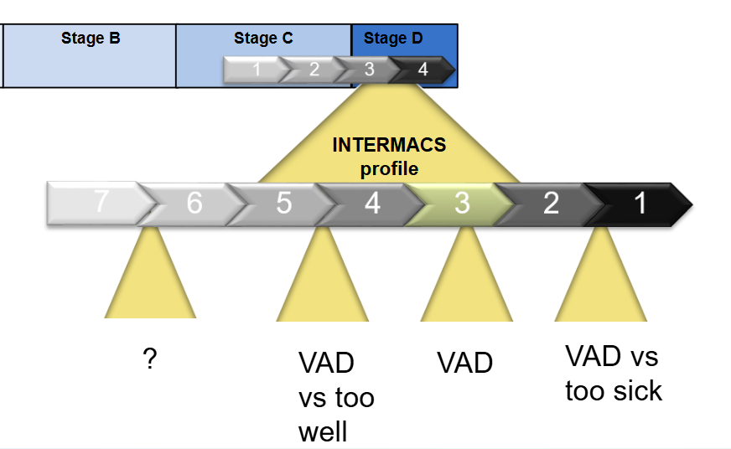
Timing of Device Therapy?
GDMT
ICD / CRT
PAP monitoring
CCM
BAT
Risk and Benefit Assessment

Slide 10
Case Presentation
Patient was implanted with CCM device. Patient showed improvement in NYHA class status to 2.
However following a trip to Arizona, he experienced his first hospitalization. His outpatient diuretics were augmented and he was hopeful to avoid hospitalizations
He was implanted with Cardiomems device.

Slide 11
Case Presentation
Careful surveillance of Cardiomems and adjustments of diuretics helped the patient avoid hospitalizations for 3 months
However, the mean PA pressure remained elevated and symptomatically patient became dyspneic at rest.
Shared Decision Making: LVAD HM3

Slide 12
Key Messages
Need to make thoughtful changes to optimize HF care
- GDMT and CRT first
- If persistent symptoms
-- Consider monitoring strategies and devices such as HeartLogic and Cardiomems
-- Consider implanted devices such as CCM and BAT
- Shared decision making is important
- Do not delay LVAD and heart transplant when appropriate

